Slide 1
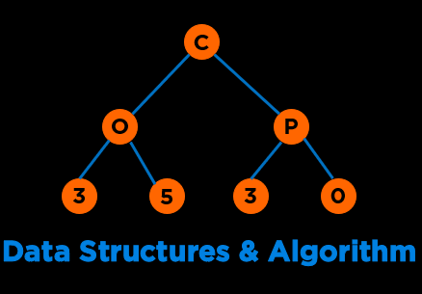
Trees
Notes:
Hi everyone, welcome to the second module of the course

Slide 2

Categories of Data Structures
Linear Ordered
Non-linear Ordered
Not Ordered
Lists
Trees
Sets
Stacks
Graphs
Tables/Maps
Queues
Notes:
Data structures are ways to collect data. There are basic categories of data structures:

Slide 3


Trees
A tree is a rooted, directed, acyclic structure. It has three properties: one root; each node has one parent; and no cycles.
25
2
15
51
5
11
65
Notes:
Data structures are ways to collect data. There are basic categories of data structures:

Slide 4

Use Cases
Family Trees
Decision Trees
File Systems
Expression Trees
Search Trees
https://commons.wikimedia.org/wiki/File:Black_family_tapestry_as_seen_at_Harry_Potter_Experience.jpg
/
root
bin
var
etc
media
image
video
audio
document
Notes:
Data structures are ways to collect data. There are basic categories of data structures:

Slide 5
Tree Terminology
Notes:
Hi everyone, welcome to the second module of the course

Slide 6
Trees: Terminology
Root
The node at the top is called the root.
25
Root
2
51
5
11
14
65
Notes:
Data structures are ways to collect data. There are basic categories of data structures:

Slide 7
Trees: Terminology
Children
Successors of a node are called children.
25
Child of 25
Child of 25
2
51
Child of 2
Child of 51
5
11
14
65
Notes:
Data structures are ways to collect data. There are basic categories of data structures:

Slide 8
Trees: Terminology
Parent
Predecessors of a node are called parent.
25
Parent of 2, 51
2
51
Parent of 14, 65
Every child has one parent
except the root. Root has no
parents.
5
11
14
65
Notes:
Data structures are ways to collect data. There are basic categories of data structures:

Slide 9
Trees: Terminology
Grandparent
Predecessors of a node’s parent are called grandparent.
25
Grandparent of 14, 65, 5, 11
2
51
5
11
14
65
Notes:
Data structures are ways to collect data. There are basic categories of data structures:

Slide 10
Trees: Terminology
Sibling
All nodes that have the same parent node are siblings.
25
2
51
2, 51 are siblings
5
11
14
65
Notes:
Data structures are ways to collect data. There are basic categories of data structures:

Slide 11
Trees: Terminology
Ancestor
All nodes that can be reached by moving only in an upward direction in the tree.
25
2
51
25, 51 are ancestors of 14
5
11
14
65
Notes:
Data structures are ways to collect data. There are basic categories of data structures:

Slide 12
Trees: Terminology
Descendent
Nodes that can be reached by moving only in a downward direction in the tree.
25
2
51
14 is a descendant of 25 and 51
5
11
14
65
Notes:
Data structures are ways to collect data. There are basic categories of data structures:

Slide 13
Trees: Terminology
Leaf
Nodes with no children are called leaf nodes or external nodes.
25
Non-leaf nodes are also called internal nodes. 25, 51, 2 are internal nodes.
2
51
5
11
14
65
5, 11, 14, 65 are Leaf Nodes
Notes:
Data structures are ways to collect data. There are basic categories of data structures:

Slide 14
Trees: Terminology
Subtree
A subtree of a node is a tree whose root is a child of that node.
25
Subtrees of 25
2
51
5
11
65
Notes:
Data structures are ways to collect data. There are basic categories of data structures:

Slide 15
Trees: Terminology
Level (Depth)
The level of a node is the distance of that node from the root.
Level 0
25
If node n is root,
Level(n) = 0
2
51
If node n is not a root,
Level(n) = level(parent) + 1
Level 1
Level 2
5
11
14
65
Notes:
Data structures are ways to collect data. There are basic categories of data structures:

Slide 16
Trees: Terminology
Height – 0 based height (based on edges)
The height of a tree is the number of nodes in the longest path from the root node to a leaf node
25
Height = 2
If tree has just the root,
Height = 0
2
51
If tree has more than the root,
Height = 1 + max(Height(children))
14
65
https://stackoverflow.com/questions/4065439/height-of-a-tree-with-only-one-node
Notes:
Data structures are ways to collect data. There are basic categories of data structures:

Slide 17
Trees: Terminology
Height – 1 based height (based on nodes)
The height of a tree is the number of nodes in the longest path from the root node to a leaf node
25
Height = 3
If tree has just the root,
Height = 1
2
51
If tree has more than the root,
Height = 1 + max(Height(children))
14
65
https://stackoverflow.com/questions/4065439/height-of-a-tree-with-only-one-node
Notes:
Data structures are ways to collect data. There are basic categories of data structures:

Slide 18
Tree Types
Notes:
Hi everyone, welcome to the second module of the course

Slide 19
Trees: Type
N-Ary Tree
A tree with each node consisting of at most n children.
Tree has three properties: one root; each node has one parent; and no cycles.
25
2
51
… n …
5
11
14
65
… n …
… n …
Notes:
Data structures are ways to collect data. There are basic categories of data structures:

Slide 20
Trees: Type
Binary Tree
A tree with each node consisting of at most two children.
25
2
51
11
65
Notes:
Data structures are ways to collect data. There are basic categories of data structures:

Slide 21
Trees: Type
Full Binary Tree
A full binary tree is a binary tree where all nodes have either 2 children or 0 children (the leaf nodes)
25
2
51
5
11
5
11
Notes:
Data structures are ways to collect data. There are basic categories of data structures:

Slide 22
Trees: Type
Perfect Binary Tree
A perfect binary tree is a full binary tree of height h with exactly 2^{h} – 1 nodes. Here, h is 1-based (height of a tree with one node is 1).
In a perfect binary tree with n nodes, the height of the tree is ceil(log₂ n).
25
2
51
5
11
14
65
h = 3 and 2^{h} – 1 = 7
n = 7 and ceil(log₂ 7) = 3
Notes:
Data structures are ways to collect data. There are basic categories of data structures:

Slide 23
Trees: Type
Complete Binary Tree
A complete binary tree is a perfect binary tree through level h - 1 with some extra leaf nodes at level h (the tree height), all towards the left
The height of a complete binary tree is also ceil(log₂ n)
25
2
51
5
11
14
Is a full tree complete? Is a complete tree full?
Notes:
Data structures are ways to collect data. There are basic categories of data structures:

Slide 24
Trees: Type
Binary Search Tree (BST)
A binary tree in which all values of a node’s left subtree or descendants to the left are less than the node and all values of a node’s right subtree are greater than the node.
An ordered binary tree.
25
12
51
5
14
34
Notes:
Data structures are ways to collect data. There are basic categories of data structures:

Slide 25
Trees Representation
Notes:
Hi everyone, welcome to the second module of the course

Slide 26
Trees: Representation
Notes:
Data structures are ways to collect data. There are basic categories of data structures:

Slide 27

Trees: Representation
Parent, i
Child, 2i, 2i+1
1
25
Array Representation
2
3
2
51
Tree[]
25
2
51
14
65
0
5
10
6
7
14
65
Notes:
Data structures are ways to collect data. There are basic categories of data structures:

Slide 28

Trees: Representation
Parent, i
Child, 2i, 2i+1
1
25
Array Representation
2
3
2
51
Tree[]
25
2
51
14
65
0
5
10
6
7
Linked Representation
14
65
class TreeNode
{
public:
int val;
TreeNode *left;
TreeNode *right;
TreeNode(int x) : val(x), left(nullptr), right(nullptr) {}
};
Notes:
Data structures are ways to collect data. There are basic categories of data structures:

Slide 29
Binary Search Trees
Notes:
Hi everyone, welcome to the second module of the course

Slide 30
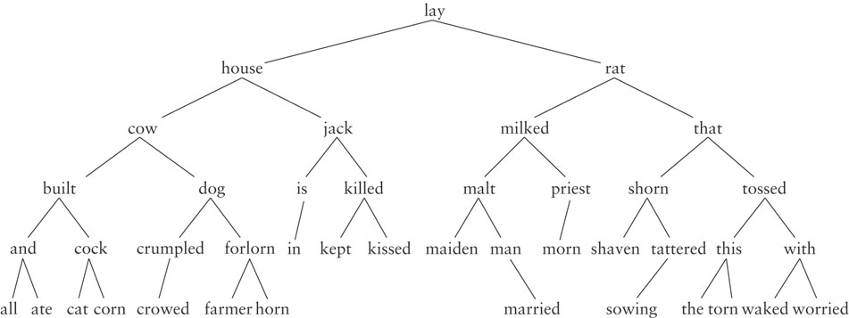
Binary Search Tree (BST): Dictionary
Notes:
Data structures are ways to collect data. There are basic categories of data structures:

Slide 31
Binary Search Tree: C++ Node Class
class TreeNode
{
public:
int val;
TreeNode *left;
TreeNode *right;
TreeNode(int x) : val(x), left(nullptr), right(nullptr) {}
};
https://onlinegdb.com/BygDgQCjI
Notes:
Track of progress, access to current and mechanism to next data element
Dereference operator to get the data

Slide 32
Binary Search Tree Search
25
12
51
5
14
34
Notes:
Data structures are ways to collect data. There are basic categories of data structures:

Slide 33
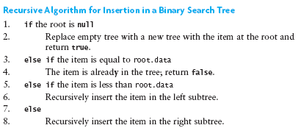
Binary Search Tree Insertion
25
12
51
5
14
34
Notes:
Data structures are ways to collect data. There are basic categories of data structures:

Slide 34
Binary Search Tree: C++ Insert
class TreeNode
{
public:
int val;
TreeNode *left;
TreeNode *right;
TreeNode(int x) : val(x), left(nullptr), right(nullptr) {}
};
TreeNode* insert(TreeNode* root, int key)
{
if (root == nullptr)
return new TreeNode(key);
if (key < root->val)
root->left = insert(root->left, key);
else
root->right = insert(root->right, key);
return root;
}
https://onlinegdb.com/BygDgQCjI
Notes:
Track of progress, access to current and mechanism to next data element
Dereference operator to get the data

Slide 35
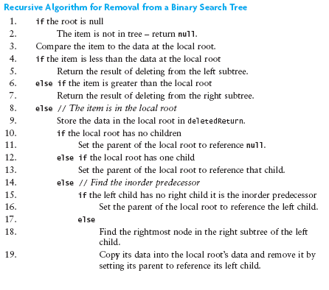
Binary Search Tree Deletion
25
12
51
5
14
34
Notes:
Data structures are ways to collect data. There are basic categories of data structures:

Slide 36
Traversals
Notes:
Hi everyone, welcome to the second module of the course

Slide 37
BST Traversals
Visiting each node in the tree
Depth First Strategy
Inorder
Preorder
Postorder
Breadth First Strategy
Traversal vs Search
Traversal requires you to visit each node; Not necessarily in search
25
12
51
5
14
2
6
Notes:
Data structures are ways to collect data. There are basic categories of data structures:

Slide 38
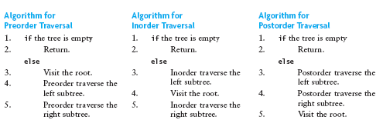
BST Traversals: Inorder
25
Strategy
Visit Left Subtree
Visit Root
Visit Right Subtree
12
51
5
14
2
6
2, 5, 6, 12, 14, 25, 51
Notes:
Data structures are ways to collect data. There are basic categories of data structures:

Slide 39
BST Traversals: Inorder
25
Strategy
Visit Left Subtree
Visit Root
Visit Right Subtree
12
51
5
14
2
6
Notes:
Data structures are ways to collect data. There are basic categories of data structures:

Slide 40
Binary Search Tree: C++ Inorder Traversal
class TreeNode
{
public:
int val;
TreeNode *left;
TreeNode *right;
TreeNode(int x) : val(x), left(nullptr), right(nullptr) {}
};
void inorder(TreeNode* head)
{
if(head == nullptr)
cout << "";
else
{
inorder(head->left);
cout << head->val << " ";
inorder(head->right);
}
}
https://onlinegdb.com/BygDgQCjI
Notes:
Track of progress, access to current and mechanism to next data element
Dereference operator to get the data

Slide 41
BST Traversals: Preorder
25
Strategy
Visit Root
Visit Left Subtree
Visit Right Subtree
12
51
5
14
2
6
Notes:
Data structures are ways to collect data. There are basic categories of data structures:

Slide 42
BST Traversals: Preorder
25
Strategy
Visit Root
Visit Left Subtree
Visit Right Subtree
12
51
5
14
2
6
25, 12, 5, 2, 6, 14, 51
Notes:
Data structures are ways to collect data. There are basic categories of data structures:

Slide 43
BST Traversals: Postorder
25
Strategy
Visit Left Subtree
Visit Right Subtree
Visit Root
12
51
5
14
2
6
Notes:
Data structures are ways to collect data. There are basic categories of data structures:

Slide 44
BST Traversals: Postorder
25
Strategy
Visit Left Subtree
Visit Right Subtree
Visit Root
12
51
5
14
2
6
2, 6, 5, 14, 12, 51, 25
Notes:
Data structures are ways to collect data. There are basic categories of data structures:

Slide 45
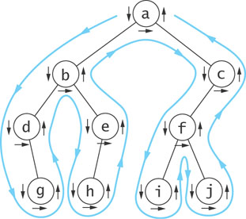
BST Traversals: Euler Tour
Visiting each node in the tree
Depth First Strategy
Preorder (down arrow)
Inorder (horizontal arrow)
Postorder (up arrow)
Notes:
Data structures are ways to collect data. There are basic categories of data structures:

Slide 46
BST Traversals: Level Order
25
Strategy
Traverse all nodes in Level 0 upto n-1
12
51
5
14
2
6
25, 12, 51, 5, 14, 2, 6
Notes:
Data structures are ways to collect data. There are basic categories of data structures:

Slide 47
Use Cases of Traversal
Notes:
Hi everyone, welcome to the second module of the course

Slide 48
Binary Tree: Sum of Right Leaves (4.2.3)
https://stepik.org/lesson/390626/step/3?unit=379726
Notes:
Track of progress, access to current and mechanism to next data element
Dereference operator to get the data

Slide 49
Binary Tree: Sum of Right Leaves (4.2.3)
void sumOfRightLeaves(TreeNode* root)
{
queue<TreeNode*> q;
int sum = 0;
if(root != NULL)
q.push(root);
while (!q.empty())
{
if (q.front()->right != NULL && q.front()->right->right == NULL && q.front()->right->left == NULL)
sum += q.front()->right->val;
if (q.front()->left != NULL)
q.push(q.front()->left);
if (q.front()->right != NULL)
q.push(q.front()->right);
q.pop();
}
cout << sum;
}
https://stepik.org/lesson/390626/step/3?unit=379726
Notes:
Track of progress, access to current and mechanism to next data element
Dereference operator to get the data

Slide 50
Binary Tree: Sum of Right Leaves (4.2.3)
void sumOfRightLeaves(TreeNode* root)
{
queue<TreeNode*> q;
int sum = 0;
if(root != NULL)
q.push(root);
while (!q.empty())
{
if (q.front()->right != NULL && q.front()->right->right == NULL && q.front()->right->left == NULL)
sum += q.front()->right->val;
if (q.front()->left != NULL)
q.push(q.front()->left);
if (q.front()->right != NULL)
q.push(q.front()->right);
q.pop();
}
cout << sum;
}
https://stepik.org/lesson/390626/step/3?unit=379726
Notes:
Track of progress, access to current and mechanism to next data element
Dereference operator to get the data

Slide 51
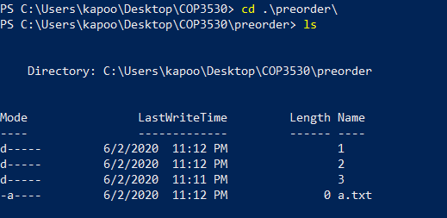
Trees Traversal: Use Cases
Preorder Traversal
Printing Directory Listings
preorder
1
2
3
a.txt
b.txt
c.txt
d.txt
https://sp19.datastructur.es/
Notes:
Data structures are ways to collect data. There are basic categories of data structures:

Slide 52
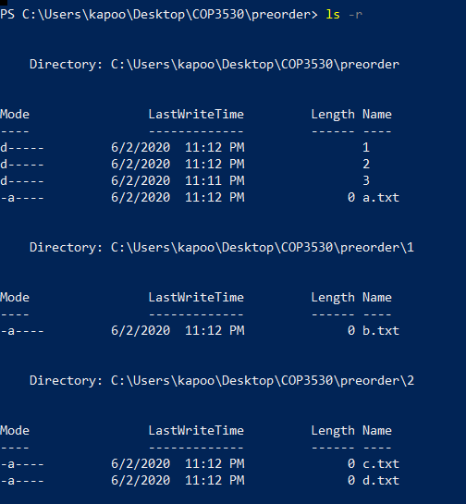
Trees Traversal: Use Cases
Preorder Traversal
Printing Directory Listings
preorder
1
2
3
a.txt
b.txt
c.txt
d.txt
https://sp19.datastructur.es/
Notes:
Data structures are ways to collect data. There are basic categories of data structures:

Slide 53
Trees Traversal: Use Cases
Preorder Traversal
Printing Directory Listings
preorder
preorder/
1/
b.txt
2/
c.txt
d.txt
3/
a.txt
1
2
3
a.txt
b.txt
c.txt
d.txt
https://sp19.datastructur.es/
Notes:
Data structures are ways to collect data. There are basic categories of data structures:

Slide 54
Trees Traversal: Use Cases
Postorder Traversal
Gathering File Sizes
postorder
1/
100
2/
200
300
3/
500
postorder/
1
2
3
a.txt
500
b.txt
c.txt
d.txt
200
300
100
https://sp19.datastructur.es/
Notes:
Data structures are ways to collect data. There are basic categories of data structures:

Slide 55
Trees Traversal: Use Cases
Postorder Traversal
Gathering File Sizes
postorder
500
0
500
1/
100
2/
200
300
3/
500
postorder/
1
2
3
a.txt
100
500
b.txt
c.txt
d.txt
200
300
100
https://sp19.datastructur.es/
Notes:
Data structures are ways to collect data. There are basic categories of data structures:

Slide 56
Trees Traversal: Use Cases
1100
Postorder Traversal
Gathering File Sizes
postorder
500
0
500
1/
100
2/
200
300
3/
500
postorder/
1
2
3
a.txt
100
500
b.txt
c.txt
d.txt
200
300
100
https://sp19.datastructur.es/
Notes:
Data structures are ways to collect data. There are basic categories of data structures:

Slide 57
Trees Traversal: Other Use Cases
Postorder Traversal
Managing memory when deleting a tree
Preorder Traversal
Creating a copy of a tree
Notes:
Data structures are ways to collect data. There are basic categories of data structures:

Slide 58

Mentimeter
Menti.com
51 60 81 5
Notes:
Array of Strings

Slide 59
Questions

Slide 60
Mentimeter
1. The maximum height of a BST with 5 nodes can be? (Assume height is 1-based, i.e. if there is one node in the tree, the root, height is 1).
Notes:
Array of Strings

Slide 61
Mentimeter
2. The minimum height of a BST with 5 nodes is? (Assume height is 1-based, i.e. if there is one node in the tree, the root, height is 1).
Notes:
Array of Strings

Slide 62
Mentimeter
3. What is the computational complexity of searching an item in a binary search tree?
Notes:
Array of Strings

Slide 63
Mentimeter
4. What is the computational complexity of searching an item in a binary search tree in the average case?
Notes:
Array of Strings

Slide 64
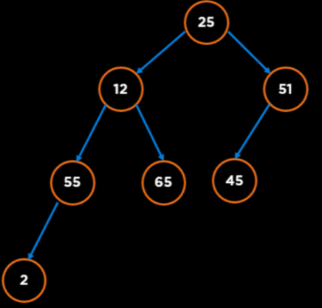
Mentimeter
5. The inorder predecessor of the node 25 in this tree is node _?
Notes:
Array of Strings

Slide 65
Mentimeter
6. The maximum number of Nodes in a 6-ary Tree of height 3 is? (Assume height is 1-based, i.e. if there is one node in the tree, the root, height is 1).
Notes:
Array of Strings

Slide 66
Mentimeter
6. The maximum number of Nodes in a 6-ary Tree of height 3 is? (Assume height is 1-based, i.e. if there is one node in the tree, the root, height is 1).
In graph theory, an m-ary tree (also known as k-ary or k-way tree) is a rooted tree in which each node has no more than m children. A binary tree is the special case where m = 2.
The total number of nodes, N in a perfect m-ary tree is (height is 0 based):
$$N=\frac{m^{h+1}−1}{m−1}$$
https://en.wikipedia.org/wiki/M-ary_tree
Notes:
Array of Strings

Slide 67
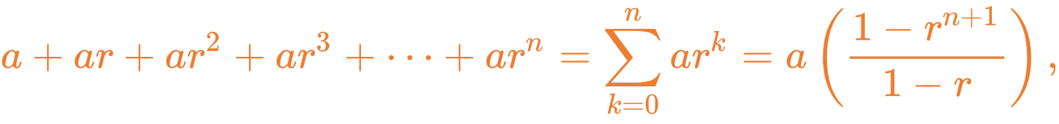
Mentimeter
6. The maximum number of Nodes in a 6-ary Tree of height 3 is? (Assume height is 1-based, i.e. if there is one node in the tree, the root, height is 1).
The total number of nodes, N in a perfect m-ary tree is (height is 0 based):
$$N=\frac{m^{h+1}−1}{m−1}$$
From GP:
https://en.wikipedia.org/wiki/M-ary_tree
Notes:
Array of Strings

Slide 68
Mentimeter
Level order Traversal:
25, 12, 51, 55, 65, 45, 2
GatorLevel Traversal
25, 51, 12, 55, 65, 45, 2
Notes:
Array of Strings

Slide 69
n-Ary Tree: Level Order Traversal (4.1.1)
https://stepik.org/lesson/357873/step/1?unit=342071
Notes:
Track of progress, access to current and mechanism to next data element
Dereference operator to get the data

Slide 70
n-Ary Tree: Level Order Traversal (4.1.1)
01 02 03 04 05 06 07 08 09 10 11 12 13 14 15 16 17 18 19 20 21 22 23 24
void levelOrder(Node* root) { queue<Node*> queue; int levelNum = 1; if (root == nullptr) return; queue.push(root); while (!queue.empty()) { int size = queue.size(); vector<int> level; for (int i = 0; i < size; i++) { Node* node = queue.front(); level.push_back(node->val); queue.pop(); for (int j = 0; j < (node->children).size(); j++) { if ((node->children)[j] != nullptr) queue.push((node->children)[j]); } } cout << "Level: " << levelNum << endl; for (int item : level) cout << item << " "; cout << endl; levelNum++; } }
https://stepik.org/lesson/357873/step/1?unit=342071
Notes:
Track of progress, access to current and mechanism to next data element
Dereference operator to get the data

Slide 71
n-Ary Tree: Level Order Traversal (4.1.1)
01 02 03 04 05 06 07 08 09 10 11 12 13 14 15 16 17 18 19 20 21 22 23
void levelOrder(Node* root) { int level = 1; queue<Node*> q; q.push(root); while (!q.empty()) { vector<int> vec; int size = q.size(); for (int i = 0; i < size; i++) { Node* temp = q.front(); vec.push_back(temp->val); q.pop(); for (auto element : temp->children) q.push(element); } cout << "Level: " << level++ << endl; for (int i = 0; i < vec.size(); i++ ) cout << vec[i] << " "; cout << endl; } }
https://stepik.org/lesson/357873/step/1?unit=342071
Notes:
Track of progress, access to current and mechanism to next data element
Dereference operator to get the data

Slide 72
More Properties Related to Height
Notes:
Hi everyone, welcome to the second module of the course

Slide 73
Trees: Terminology
Height
The height of a tree is the number of nodes in the longest path from the root node to a leaf node
25
Height = 3
If tree has just the root,
Height = 1
2
51
If tree has more nodes than the root,
Height = 1 + max(Height(children))
14
65
Notes:
Data structures are ways to collect data. There are basic categories of data structures:

Slide 74
Trees: Terminology
Height of a Node
The height of a node is the number of nodes in the longest path from the node to a leaf node
25
Height (25) = 3
Height (2) = 1
2
51
14
65
Height (14) = 1
Notes:
Data structures are ways to collect data. There are basic categories of data structures:

Slide 75
Trees: Relationship between Height and Number of Nodes
Minimum number of Nodes in a Tree with Height, h
Notes:
Data structures are ways to collect data. There are basic categories of data structures:

Slide 76
Trees: Relationship between Height and Number of Nodes
Minimum number of Nodes in a Tree with Height, h
If height = h, at least one node at each level, therefore
Number of Nodes, n = h
Height, h = 3
25
Spindly Tree
51
65
Notes:
Data structures are ways to collect data. There are basic categories of data structures:

Slide 77
Trees: Relationship between Height and Number of Nodes
Maximum number of Nodes in a Tree with Height, h
Notes:
Data structures are ways to collect data. There are basic categories of data structures:

Slide 78
Trees: Relationship between Height and Number of Nodes
Maximum number of Nodes in a Tree with Height, h
If height = h, all possible node at each level, therefore
Number of Nodes, n = 1 + 2 + 4 + … + 2^{h-1} = 2^{h} - 1
25
Height, h = 3
Perfect Binary Tree
Bushy Tree
2
51
https://en.wikipedia.org/wiki/1_%2B_2_%2B_4_%2B_8_%2B_%E2%8B%AF
5
11
14
65
Notes:
Data structures are ways to collect data. There are basic categories of data structures:

Slide 79
Trees: Relationship between Height and Number of Nodes
Number of Nodes is between h and 2^{h} - 1
h <= n <= 2^{h} - 1
n + 1 <= 2^{h}
log (n + 1) <= log (2^{h} )
log (n + 1) <= log (2^{h} )
log (n + 1) <= h
Height of a Tree, h is between log₂ (n+1) and n
Notes:
Data structures are ways to collect data. There are basic categories of data structures:

Slide 80
Trees Height: Takeaway
Trees with n nodes can have a height that is proportional to n or proportional to log (n).
For good performance we want a tree that is as perfect as possible or as “bushy” as possible, i.e. height ~ log (n)
Notes:
Data structures are ways to collect data. There are basic categories of data structures:

Slide 81
BST Performance
Notes:
Hi everyone, welcome to the second module of the course

Slide 82
BST Insertion
n! different ways to insert n elements
25
65
51
85
51
65
91
85
25
91
Notes:
Data structures are ways to collect data. There are basic categories of data structures:

Slide 83
BST Insert, Delete and Search
Worst Case ~ Height = n
And Common Operations will be O(n)
25
51
65
85
91
Notes:
Data structures are ways to collect data. There are basic categories of data structures:

Slide 84
BST Insert, Delete and Search
Average Case ~ Height = log n
And Common Operations will be O(log n)
25
2
51
5
11
65
Reed, 2003: http://citeseerx.ist.psu.edu/viewdoc/download?doi=10.1.1.152.1289&rep=rep1&type=pdf
Notes:
Data structures are ways to collect data. There are basic categories of data structures:

Slide 85
BST Insert, Delete and Search
Best Case ~ Height = log n
And Common Operations will be O(1)
25
2
51
5
11
65
Notes:
Data structures are ways to collect data. There are basic categories of data structures:

Slide 86
How do we fix the Worst Case?
Never add new leaves at the bottom: Increase size of node
Transform the “Spindly” Tree to “Bushy Tree” using Tools and Algorithms
25
51
65
85
91
Notes:
Data structures are ways to collect data. There are basic categories of data structures:

Slide 87
Questions

